Slide 1

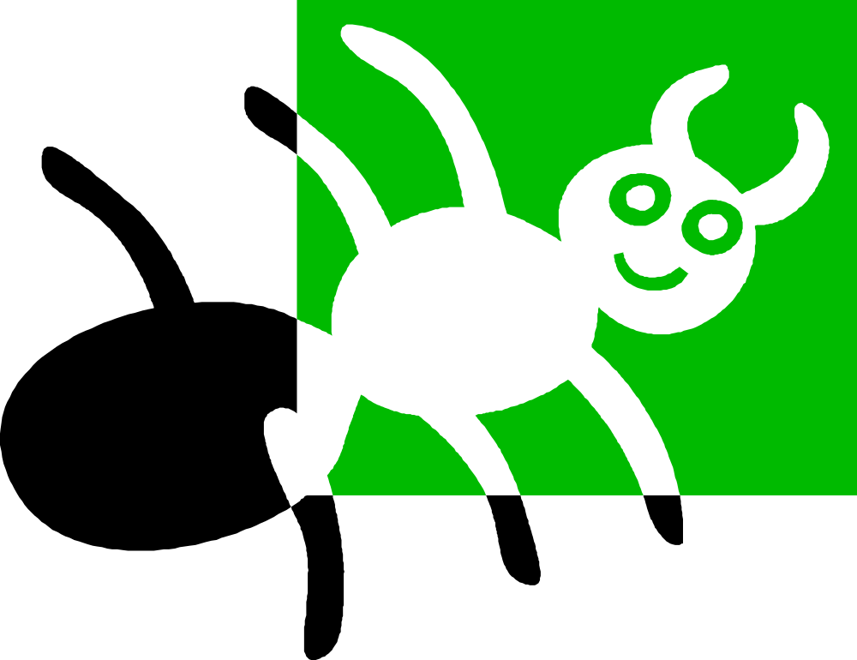
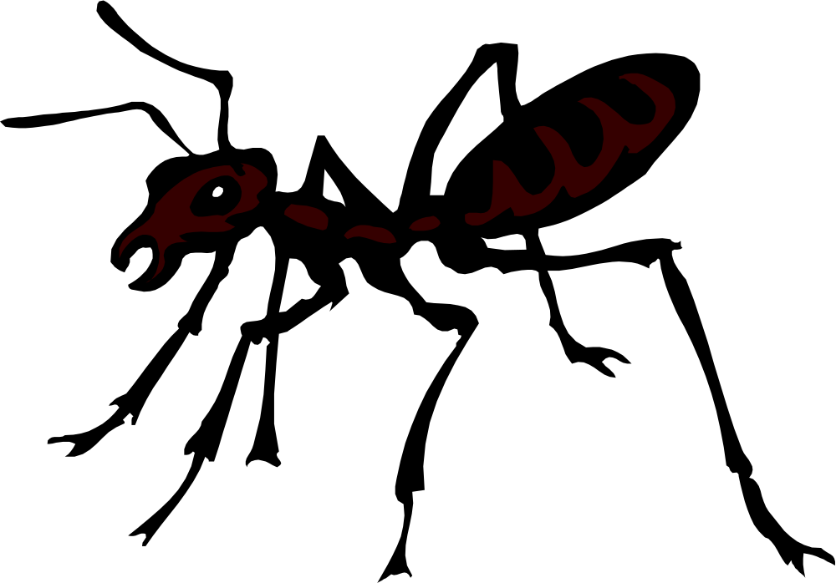


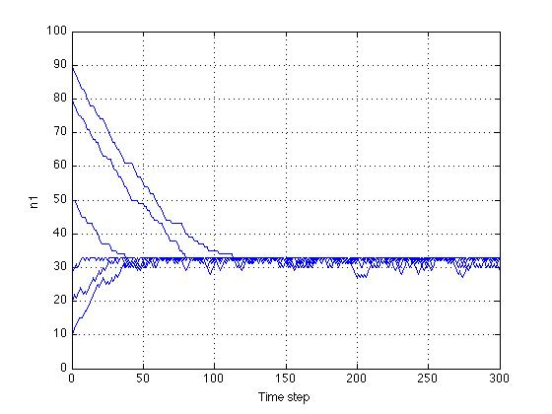
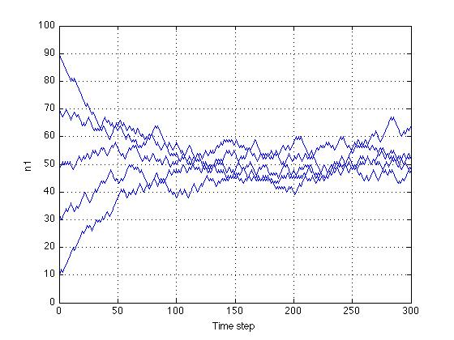
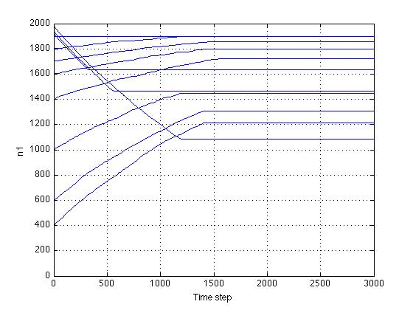

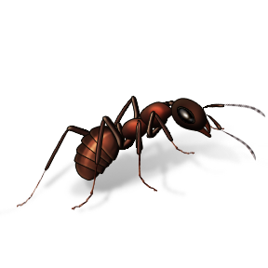


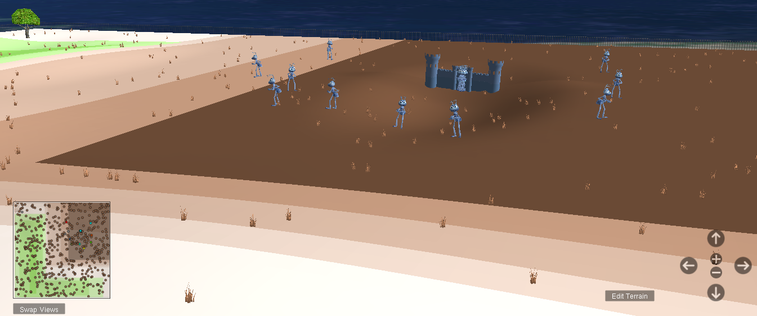

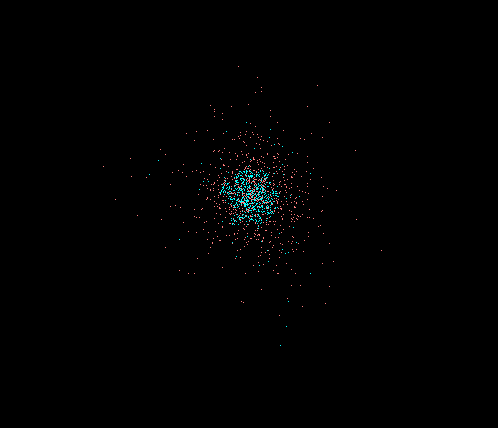


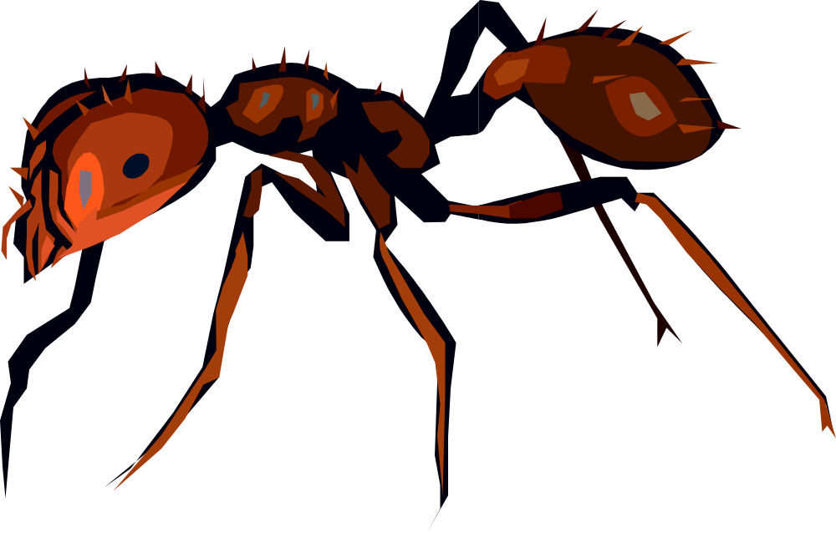

Dr. Adam Norris
Eric Benzel
Erik Bergal
Albert Como
Connor Janowiak
Donna Kuntzler
J. Patrick O’Brien
Carly Smith
Jonathan Varkovitzky
Carrie Weidner
Ant Colonies Serve as excellent examples of a network without any sort of central organization. In fact, contrary to popular belief, the Queen has no control over the everyday operations of the colony. The Queen mates once and then lives in a dark hole for the rest of her life (15 to 20 years) laying eggs. When the Queen dies, the colony dies with her.
The reason why this is interesting for research purposes is because there is no central control of any sort; however, global behavior is absolutely necessary for the survival of the colony. So, how do ants decide what to do without global knowledge? How does a colony function without a commander?
The colony carries on day-to-day life collecting food, removing dead ants and garbage, feeding larvae, and maintaining the nest in the face of external stimuli (rain, children, pets, and other threats). With the exception of the queen, any ant can have any role: forager, nest maintenance, midden worker, patroller. The way the ants move from task to task is directional (see the diagram below), and there are still many questions about just how this task allocation occurs (this issue is certainly… bugging… researchers). By the end of the day, however, the ants always reach equilibrium in their task distribution.
Thus, we are forced to ask
(1) How does an ant decide what task it is performing?
(2) How does the colony respond to external stimuli?
(3) How does the task allocation reach equilibrium?
(4) How does each ant know exactly what each task is?
Debrah Gordon has completed 20 years of field research in New Mexico on this subject, and her research will serve as the foundation for our research on this project.
Other current approaches to modeling ant colony behavior include the network approach;
However, our research focuses on Agent Based Modeling.
In Agent Based Modeling, each individual ant, or agent, has its own set of rules. Agents are created and are then allowed to interact with each other based on a limited number of basis behaviors. The basis behaviors of an ant may include following, exploring, dispersing, picking up, returning, or converging.
In order to implement these basis behaviors, our research takes advantage of the Java and Starlogo platforms. In both platforms, we are able to model ant colony organization and movement in an agent based approach. While Java is less computationally expensive, and therefore can run more sophisticated simulations, Starlogo offers a more user-friendly visualization of the model.
Nest Maintenance
Midden Work
Patrol
Ants performing certain tasks can only switch to certain other tasks on a given day
Agent Based Modeling in Starlogo
Ultimately, we hope to use simple basis behaviors to try and model the complex behavior of social insects.
Then, we will compare our results to actual data from Gordon’s research to test the accuracy of our basis behaviors
Agent Based Modeling in Starlogo
While the agent based approach does offer substantial benefits over conventional models, this approach is weighed down by costs that the other models do not endure. On the positive side, agent based modeling allows for more accurate simulations given the limited knowledge of each ant. Agent based modeling also provides clearly defined algorithms which produce easier simulations of the physical parameters that the ants face in reality. Unfortunately, however, these benefits come at the cost of the ability to compute the simulations for a large number or agents as these models are quite computationally expensive. Furthermore, agent based modeling demands that we produce the basis behaviors that govern the simulation, which can often be a formidible task.
The antiquated view is full of mostly large and unweildy equations.
Ant colonies act like:
(1) Neural networks
(2) Immune Responses
(3) Human interaction in city planning
(3) Social Networks
Understanding ants may give us the ability to better understand these other institutions and advance knowledge in all four of these realms.

